Slide 1


Movie rating and Box-office prediction
CE7454 - Group 26
Li Jie, Shen Meng, Wang Ruihang

Slide 2
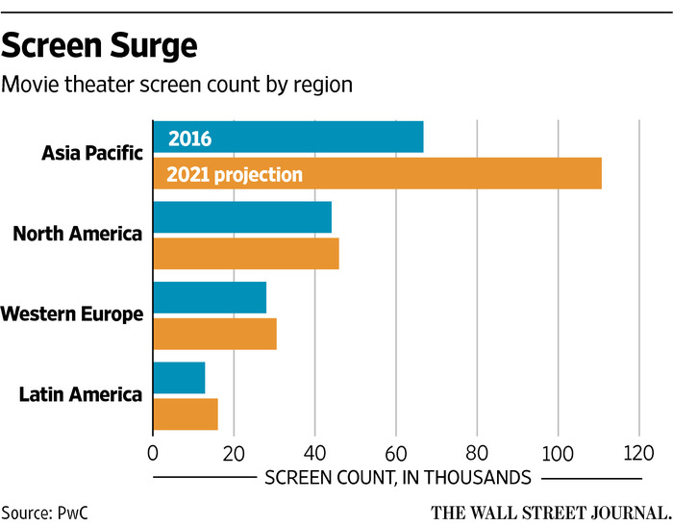

Motivation
The world’s movie industry has witnessed unprecedented boom in recent years

Slide 3
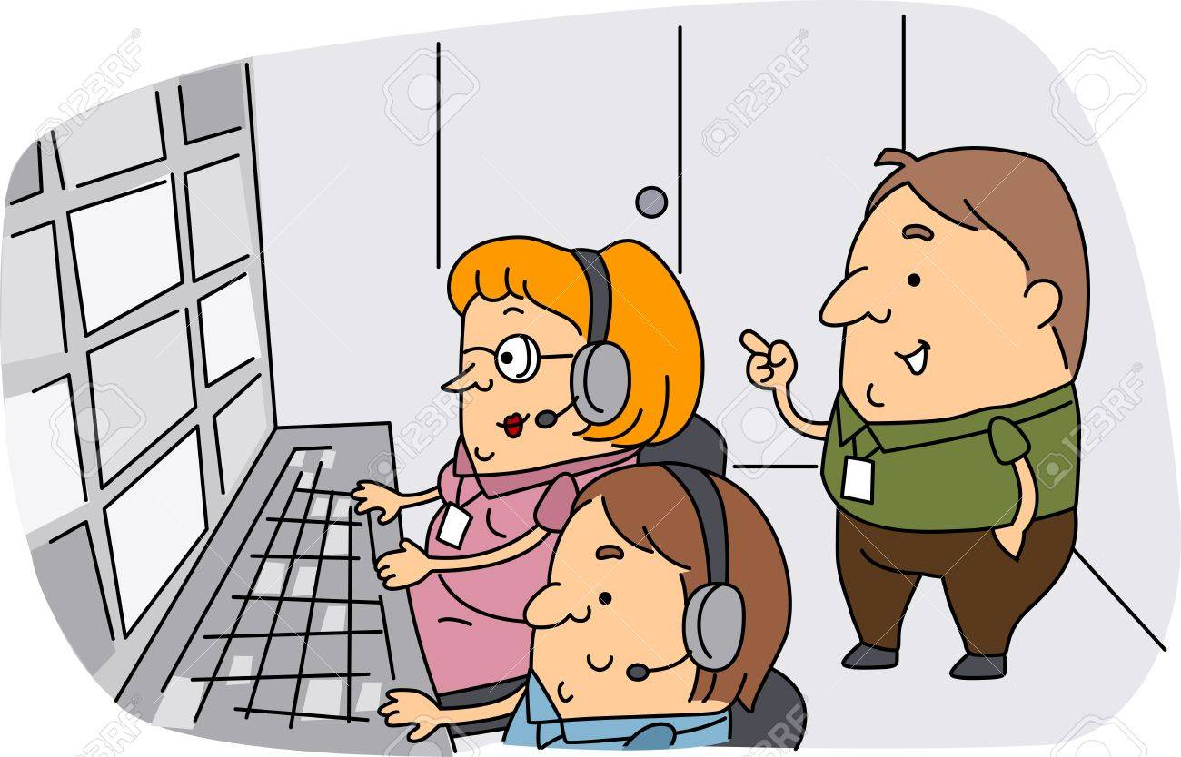


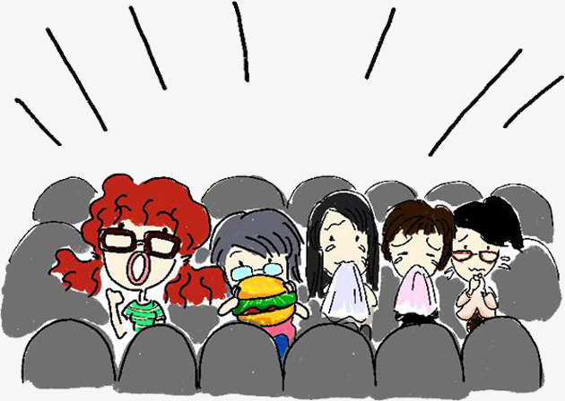
Motivation
Reliable prediction
Producer
Box-office
Rating
Reduce financial risk
Improve quality of experience
Audience

Slide 4




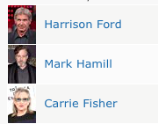

Web Scraper
Online database of movie
Rated by regular voters
Maintained by Amazon
Develop the web scraper
Match the content (e.g. actors)
Tools: Python3, Requests, Pyquery

Slide 5

Preprocessing
Scraper
Create poster dataset class
Image resize
Extract story line
Filter movie information
Match and clean data
One hot encoding of vector data
Concatenate features
Visualization
Convert numerical data to NumPy type

Slide 6
Visualization
Profitable vs. non-profitable
Movie ratings distribution
48.1% are profitable
Ratings are centered at 6.5
Statistics of 6,574 movies after preprocessing

Slide 7
Visualization
Average rating of different genres

Slide 8
Visualization
Profit of different genres

Slide 9
Visualization
Release Year and Duration can also have an impact on movie rating

Slide 10
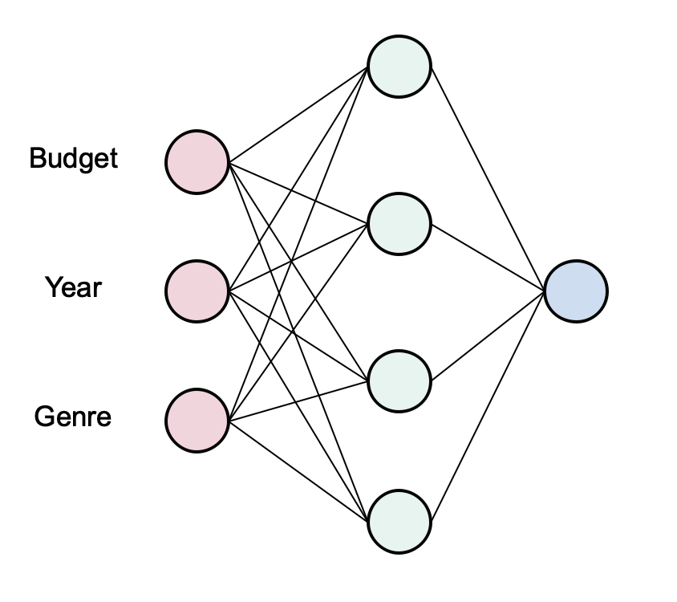
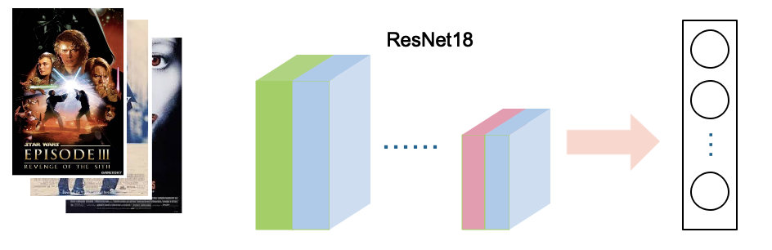
Baseline
MLP
Vanilla CNN
ResNet18

Slide 11
Baseline
Training loss of MLP for rating prediction
Training loss of ResNet18 for rating prediction

Slide 12
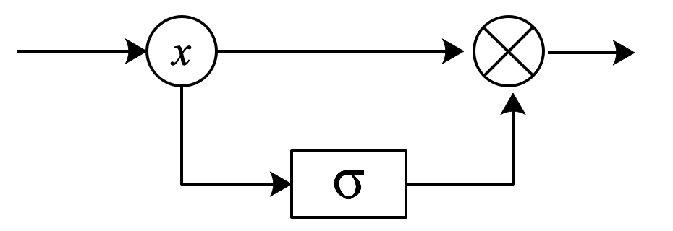
Proposed solution

Slide 13
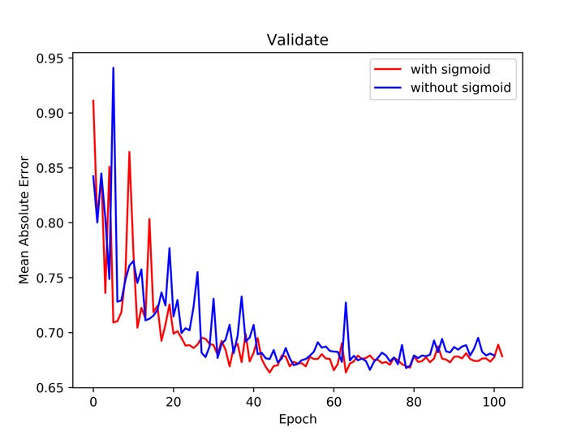
CNN Gate ：0.06
LSTM Gate：0.50
This indicates that Model takes more information from Story Line than from Posters while doing rating prediction.

Slide 14
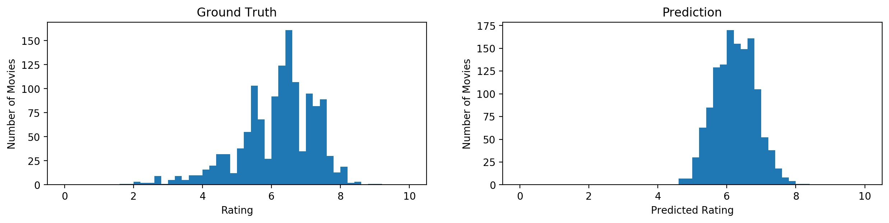
Rating Distribution Ground Truth vs. Prediction

Slide 15
Box Office
We use the same network to predict whether a movie could gain. (Two-class classification task)
Precision | 0.663
Recall | 0.626
F1_Score | 0.644
Movie success is an unpredictable problem *
* Sharda R, Delen D (2006) Predicting box-office success of motion pictures with neural networks. Expert Syst Appl 30(2):243–254

Slide 16
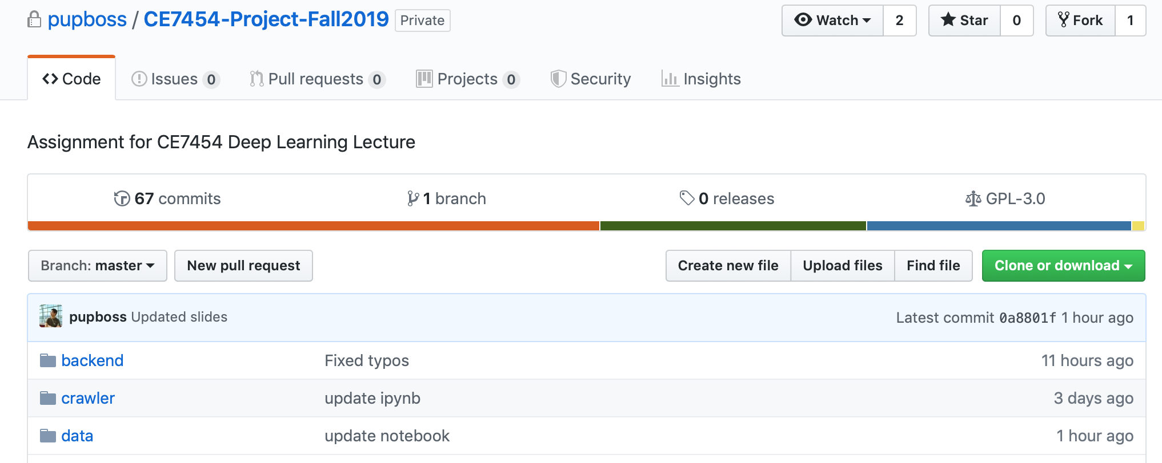
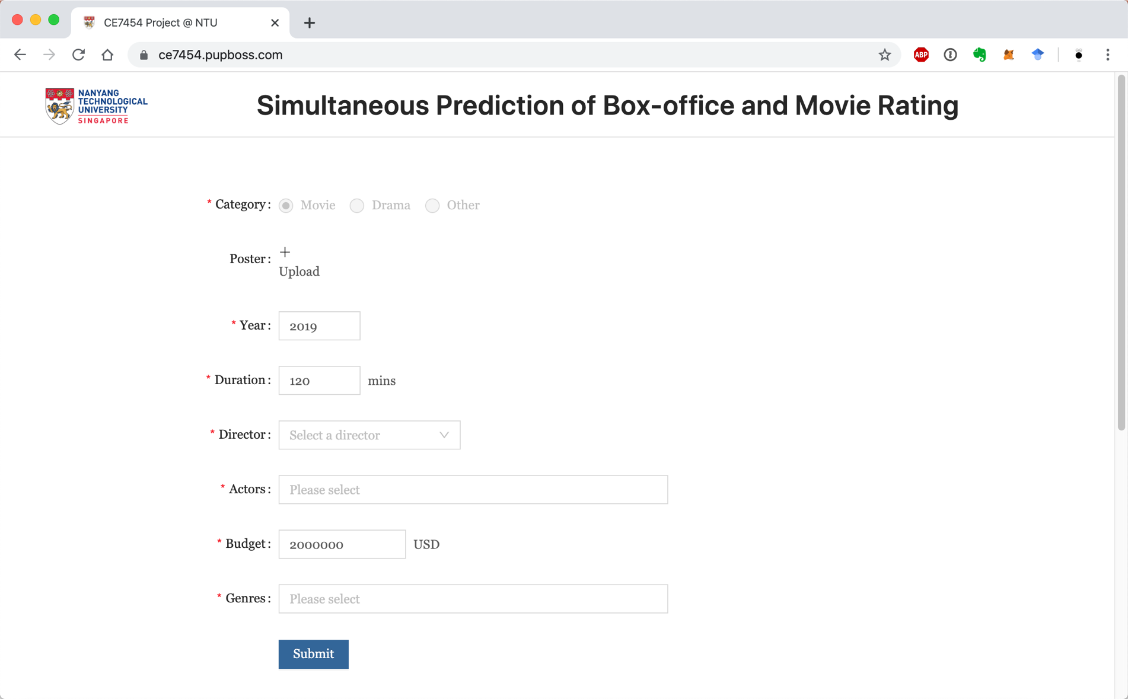
GitHub
https://github.com/pupboss/CE7454-Project-Fall2019
Online Demo
https://ce7454.pupboss.com

Slide 17
Contributions
Task | Developed by
Web Scraper | Shen Meng, Li Jie
Preprocessing & Visualization | Wang Ruihang, Shen Meng, Li Jie
Network Design | Shen Meng, Wang Ruihang
Online Demo | Li Jie
PPT, infographics & notebook | Wang Ruihang, Shen Meng, Li Jie

Slide 18
Thanks！

